Slide 1
Magnetic Force & The Motor Principle
Magnetic Fields & Forces

Slide 2
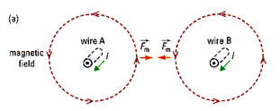
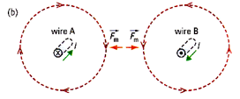
Recall – Force Between Two Parallel Wires
Wires Attract When:
Current is in the same direction
Wires Repel When:
Current is in opposite directions

Slide 3
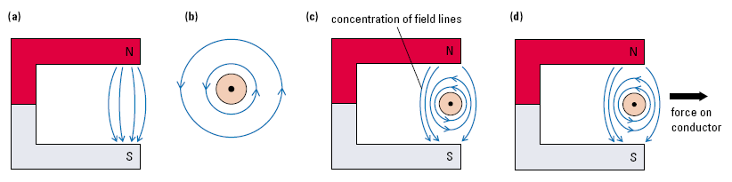
Motor Principle (Fig A & B)
English physicist Michael Faraday (1791–1867) determined that the magnetic field of a permanent magnet can exert a force on the charges in a current-carrying conductor.

Slide 4
Motor Principle (Fig C)
To the left of the conductor, the field lines point in the same direction and tend to reinforce one another (add), producing a strong magnetic field.
To the right, the fields are opposed and, as a result, tend to cancel one another, producing a weaker field.
Add
Cancel

Slide 5
Motor Principle (Fig D)
This difference in field strength results in a force to the right on the conductor.
If either the external field or the direction of the electric current were reversed, the force would act in the opposite direction.

Slide 6
Motor Principle - Definition
A current-carrying conductor that cuts across external magnetic field lines experiences a force perpendicular to both the magnetic field and the direction of electric current.
The magnitude of this force depends on:
the magnitude of the external magnetic field
the magnitude of the current,
the angle between the conductor and the magnetic field it cuts across.

Slide 7
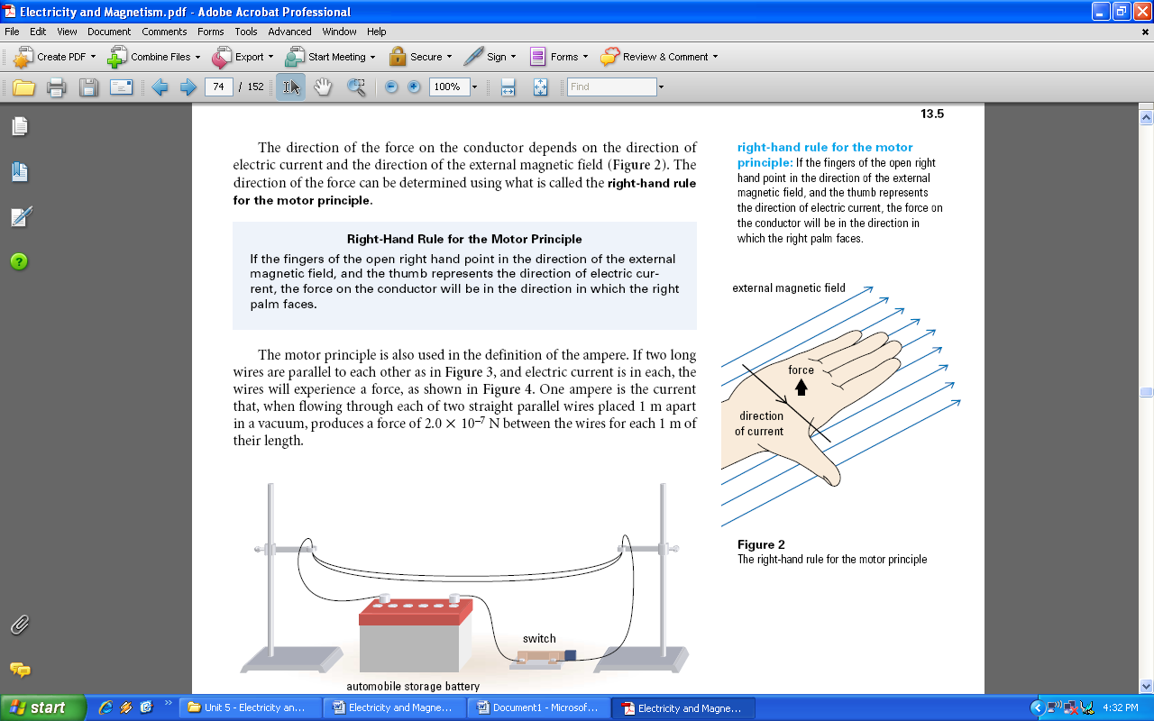
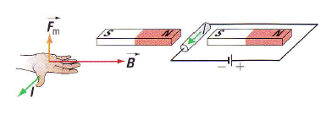
Right Hand for Magnetic Force
Direction of magnetic force can be determined as follows:
Thumb points in direction of current
Fingers point in direction of magnetic field
Palm of hand points in direction of force
F

Slide 8
Force on a Wire
When a current-carrying conductor is in an external magnetic field, but is not parallel to the field, it experiences a magnetic force.
Note: When the conductor is parallel to the field there is no force.
N
N
I
x
Current into Page
S
S
I
N
S
B

Slide 9
Force on a Wire
When a current-carrying conductor is in an external magnetic field, but is not parallel to the field, it experiences a magnetic force.
Note: When the conductor is parallel to the field there is no force.
N
N
Force out of Page
F
Current into Page
I
x
F
S
S
I
N
S
No Force I and B
Parallel
B

Slide 10
Predict the Force
A.
B.
X X X X X X
X X X X X X
X X X X X X
X X X X X X
• • • • • •
• • • • • •
• • • • • •
• • • • • •
I
I
B into page
B out of page
C.
I
D.
• • • • • •
• • • • • •
• • • • • •
• • • • • •
I
B to the left
B out of page

Slide 11
Predict the Force
E.
B to the left
F.
B to the left
X
•
I
Current in and out

Slide 12
Motors & Generators

Slide 13
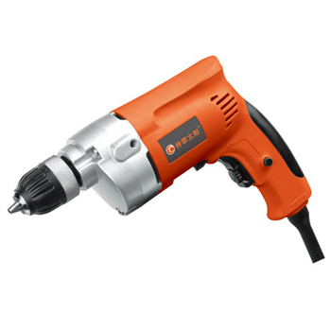
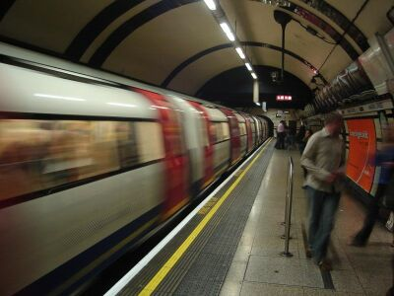
Electric Motors
Electric motors are used in cooling fans for computers, in refrigerators, in electric cars, in power tools such as electric drills, and even in many remote-controlled toys.
Many subway systems use electric motors as a clean and silent way to power their trains.

Slide 14
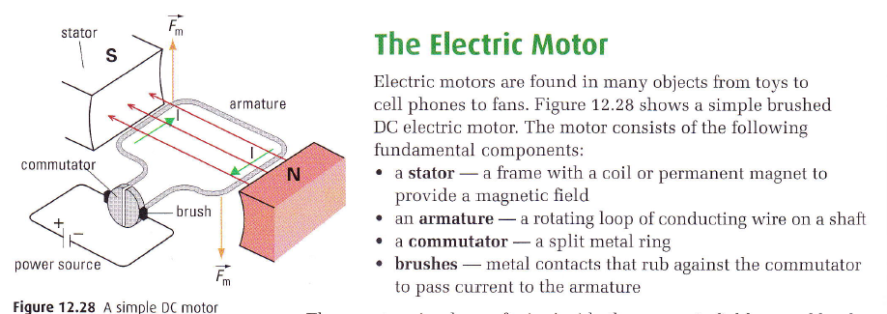
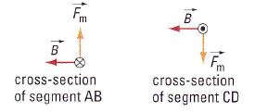
Simple DC Motor

Slide 15
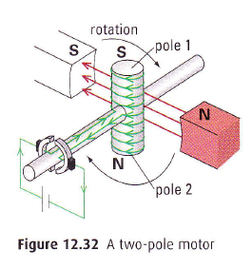
Two Pole Motor
Solenoid replaces loop of wire.
Current in solenoid creates North and South pole.
Magnetic attraction and repulsion causes armature to spin.
Commutator reverses current each ½ spin

Slide 16
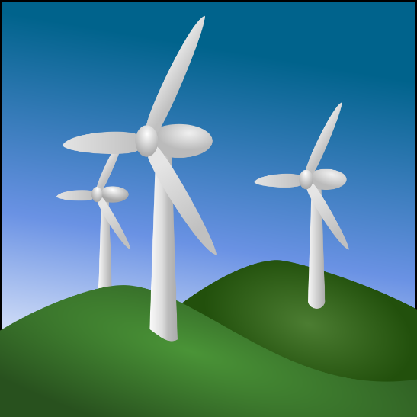
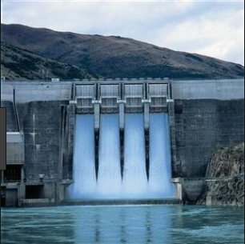
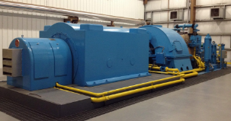
Electric Generators & Turbines
Generators operate like motors in reverse.
Mechanical energy from renewable & non renewable sources are used to spin magnets and coils of wire.
Electric current is produced by the spinning magnets and coils.

Slide 17
Michael Faraday- 1831
Faraday’s Law of Electromagnetic Induction
A changing magnetic field in the presence of a conductor will induce charge to flow in a conductor.
● basis of electric generating turbines
wind
water
steam
Generates
current in conducting coils
Rotates
magnets
● Complement to Oersted’s Law of Electromagnetism
Current
(moving charge)
Oersted
Magnetic
Field
Faraday

Slide 19
Section 13.5 Questions:
Page 489 #’s 1-8
Read pages 496-498
Practice Questions
Page 498 #’s 1-4

Slide 20
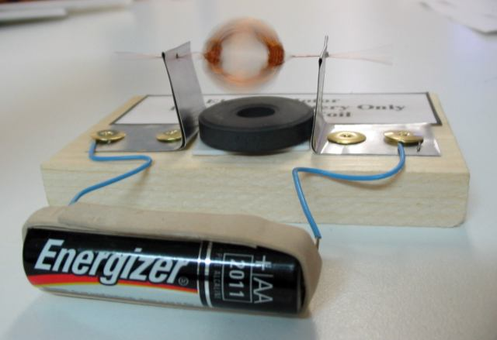
Motor Principle

Slide 21
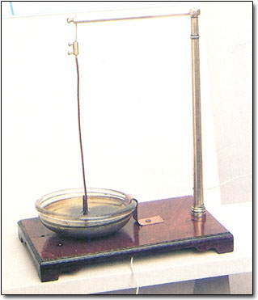
Motor Principle
English physicist Michael Faraday (1791–1867) set out to prove that, as a wire carrying electric current could cause a magnetized compass needle to move, so in reverse a magnet could cause a current-carrying wire to move. Suspending a piece of wire above a bowl of mercury in which he had fixed a magnet upright, Faraday connected the wire to a battery, and the wire began to rotate.

Slide 22
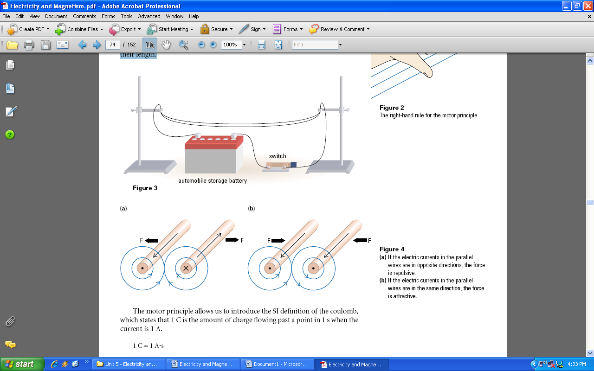
Motor Principle
The motor principle is also used in the definition of the ampere. If two long wires are parallel to each other as in the figure, and electric current is in each, the wires will experience a force, as shown in the figure. One ampere is the current that, when flowing through each of two straight parallel wires placed 1 m apart in a vacuum, produces a force of 2.0 x 10^{–7} N between the wires for each 1 m of their length.

